Slide 1
The Cell Processor: Technological Breakthrough or Yet Another Over-hyped Chip?
Prof. Milo Martin for CIS700

Slide 2
Agenda
Cell overview
PlayStation 2 review
More on the Cell (from Peter Hofstee’s HPCA slides)
Programming the Cell (brief)
Impact & Speculation

Slide 3
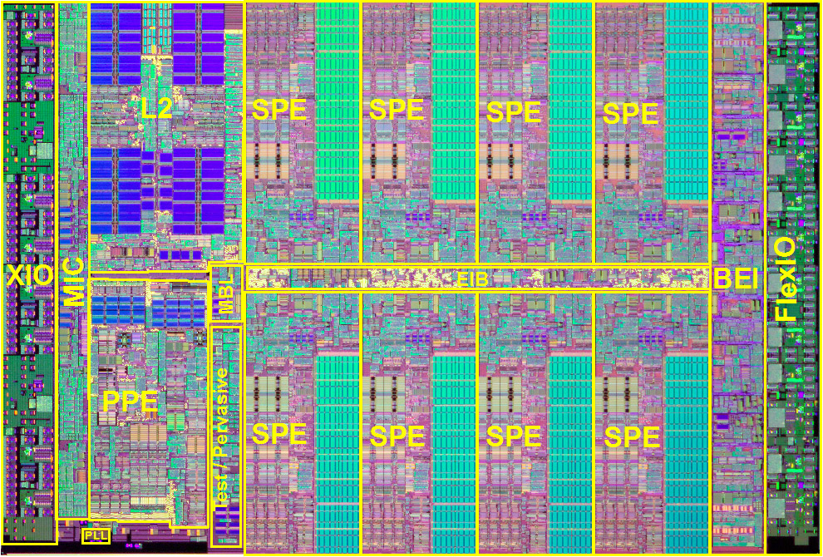
Cell Overview
Cell Prototype Die (Pham et al, ISSCC 2005)
S
P
U
S
P
U
S
P
U
S
P
U
P
P
U
M
I
C
R
R
A
C
B
I
C
MIB
S
P
U
S
P
U
S
P
U
S
P
U
IBM/Toshiba/Sony joint project - 4-5 years, 400 designers
  234 million transistors, 4+ Ghz
  256 Gflops (billions of floating pointer operations per second)

Slide 4
Cell Overview - Main Processor
Cell Prototype Die (Pham et al, ISSCC 2005)
S
P
U
S
P
U
S
P
U
S
P
U
P
P
U
M
I
C
R
R
A
C
B
I
C
MIB
S
P
U
S
P
U
S
P
U
S
P
U
One 64-bit PowerPC processor
  4+ Ghz, dual issue, two threads
  512 kB of second-level cache

Slide 5
Cell Overview - SPE
Cell Prototype Die (Pham et al, ISSCC 2005)
S
P
U
S
P
U
S
P
U
S
P
U
P
P
U
M
I
C
R
R
A
C
B
I
C
MIB
S
P
U
S
P
U
S
P
U
S
P
U
Eight Synergistic Processor Elements
  Or “Streaming Processor Elements”
  Co-processors with dedicated 256kB of memory (not cache)

Slide 6
Cell Overview - SPE
Cell Prototype Die (Pham et al, ISSCC 2005)
S
P
U
S
P
U
S
P
U
S
P
U
P
P
U
M
I
C
R
R
A
C
B
I
C
MIB
S
P
U
S
P
U
S
P
U
S
P
U
Synergistic Processor Elements
  Or “Streaming Processor Elements”
  Co-processors with dedicated 256kB of memory (not cache)

Slide 7
Cell Overview - Memory and I/O
Cell Prototype Die (Pham et al, ISSCC 2005)
S
P
U
S
P
U
S
P
U
S
P
U
P
P
U
M
I
C
R
R
A
C
B
I
C
MIB
S
P
U
S
P
U
S
P
U
S
P
U
Dual Rambus XDR memory controllers (on chip)
  25.6 GB/sec of memory bandwidth
76.8 GB/s chip-to-chip bandwidth (to off-chip GPU)

Slide 8
Agenda
Cell overview
PlayStation 2 review
More on the Cell (from Peter Hofstee’s HPCA slides)
Programming the Cell (brief)
Impact & Speculation

Slide 9
Game Consoles Review
First approach
  Conventional CPU does everything
  PlayStation 1: 34 MHz MIPS R4000
Better approach
  Conventional CPU (with MMX, SSE…) + Rendering card
  Xbox: 500MHz PentiumIII + NVIDIA GeForce2
Another approach
  Specialized graphics CPU (rendering included)
  PlayStation 2
Coming soon
  PlayStation 3 will use IBM’s “Cell” processor (today)
  Xbox 2
(Based on slides from Prof. Amir Roth)

Slide 10
Sony PlayStation 2
3 chip chipset (later merged onto one chip)
  Appeared in 2Q2000
  Most powerful graphics chipset (at the time)
    Scene/geometry: 6.2 GFLOPS
    Geometry/rendering: 75 M triangles per second
    Rendering/frame-buffer: 2.4 B pixels per second
Emotion
Engine
(EE)
Graphics
Synthesizer
(GS)
Display
I/O
Processor
Sound, DVD, PCMCIA
DRAM
USB
(Based on slides from Prof. Amir Roth)

Slide 11
Emotion Engine
Generates triangles (75M/s)
  300MHz 64-bit, 2-way superscalar MIPS CPU
    128-bit integer SIMD mode
    16KB I$, 8KB D$, 16KB scratchpad for “stream” data
  2 300MHz 4-way, single-precision FP vector units
    1 for physical modeling “emotion” (CPU control)
    1 for shading and geometry (asynchronous, microcode)
  On-chip dedicated MPEG2 decoder (DVD-player)
2-way
MIPS
CPU
4-way
FP
vector0
4-way
FP
vector1
Vertex
Iface
2.4GB/s
MBus
MPEG
I/O
(Based on slides from Prof. Amir Roth)

Slide 12
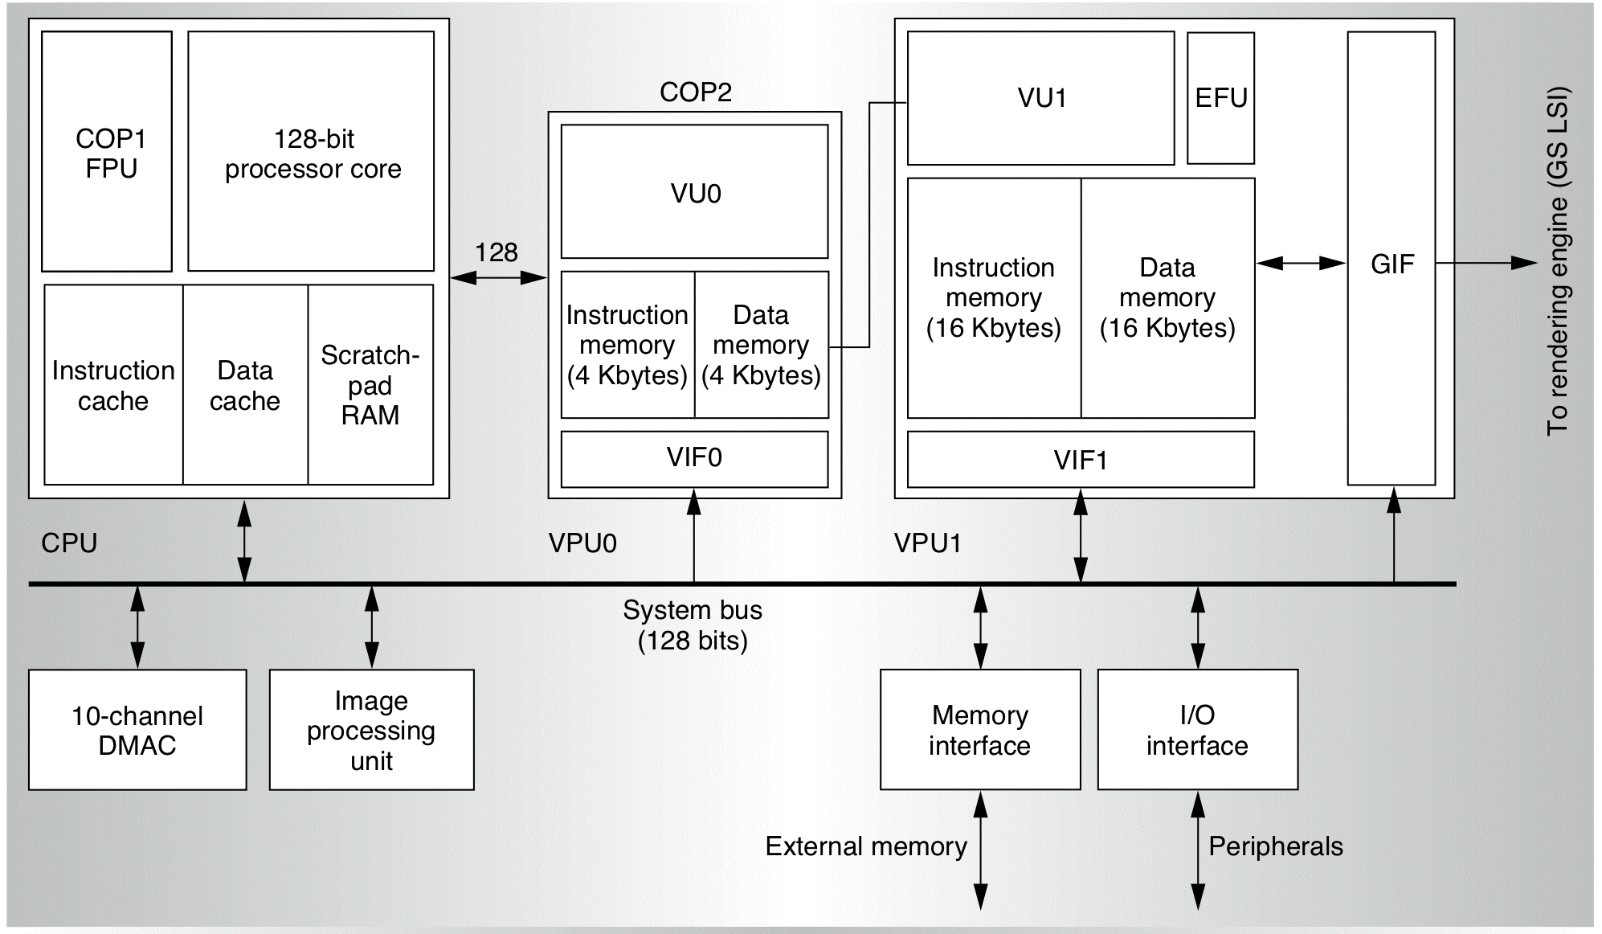
PlayStation 2 Block Diagram
Source: IEEE Micro, March/April 2000

Slide 13
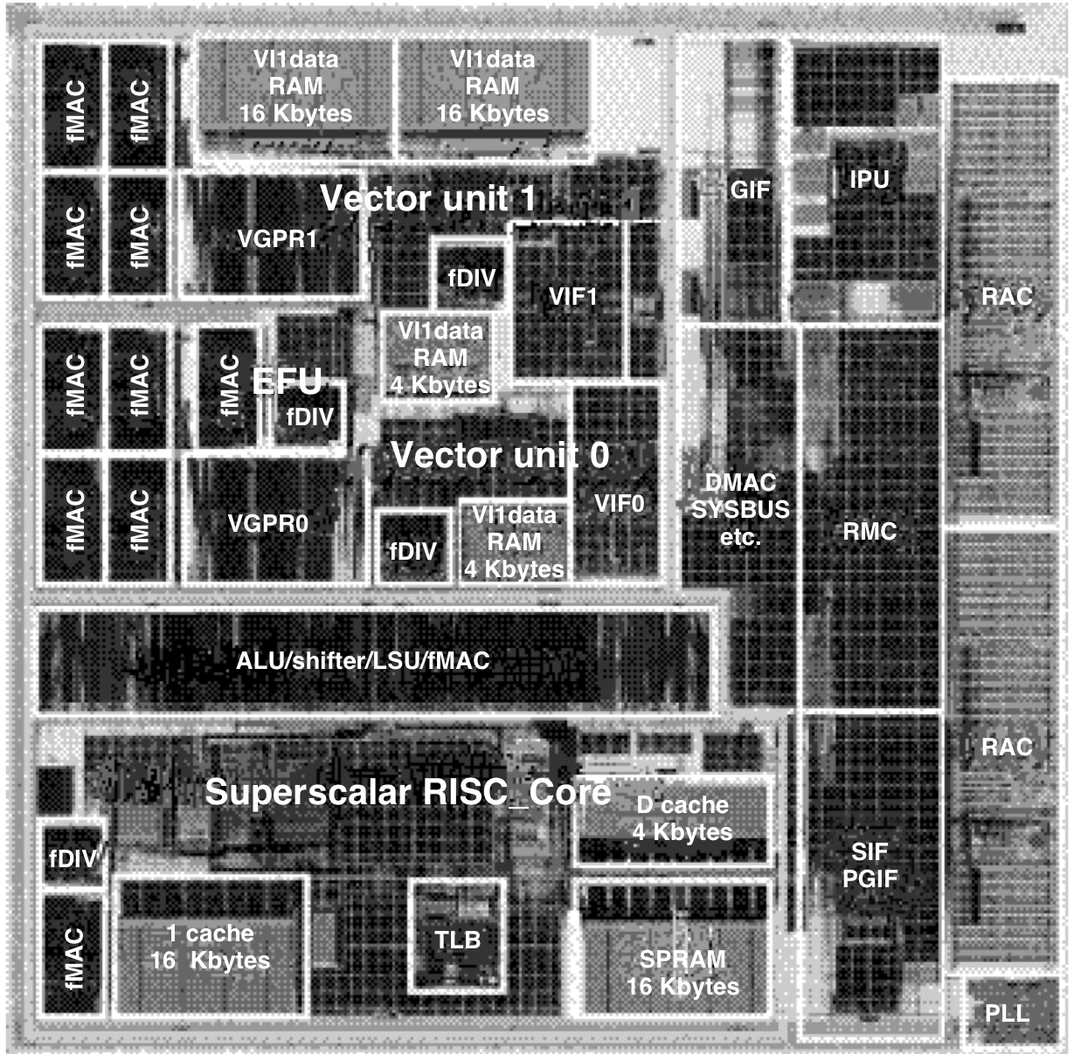
PlayStation 2 Die Photo
Source: IEEE Micro, March/April 2000

Slide 14
Vector (Emotion) Units
Emotion: physical modeling
Dominant operation: single-precision FP matrix multiply
  4-fully pipelined, 3-cycle FMACs (multiply-and-accumulate),
  One 4-cycle FP divide
  32 128-bit FP regs (4 x 32-bit single-precision FP)
  1 matrix multiply  7 cycles (6.2 GFLOPS)
32
128-bit FP regs
Micro
code
F
M
A
C
F
M
A
C
F
M
A
C
F
M
A
C
F
D
I
V
F
M
A
C
A
L
U
V
L
S
U
16KB
VMem
(Based on slides from Prof. Amir Roth)

Slide 15
Graphics Synthesizer
Triangles & pixels (2.4 B/s)
  16 150 MHz pixel pipelines
    Full functionality: alpha, texture, bump, MIPmap, antialias
  4MB embedded DRAM frame buffer, Z-buffer
16 150 MHz
pixel pipelines
Tex0
Scan
line
Tex1
Bump
Z Buffer
Frame Buffer (4MB)
(Based on slides from Prof. Amir Roth)

Slide 16
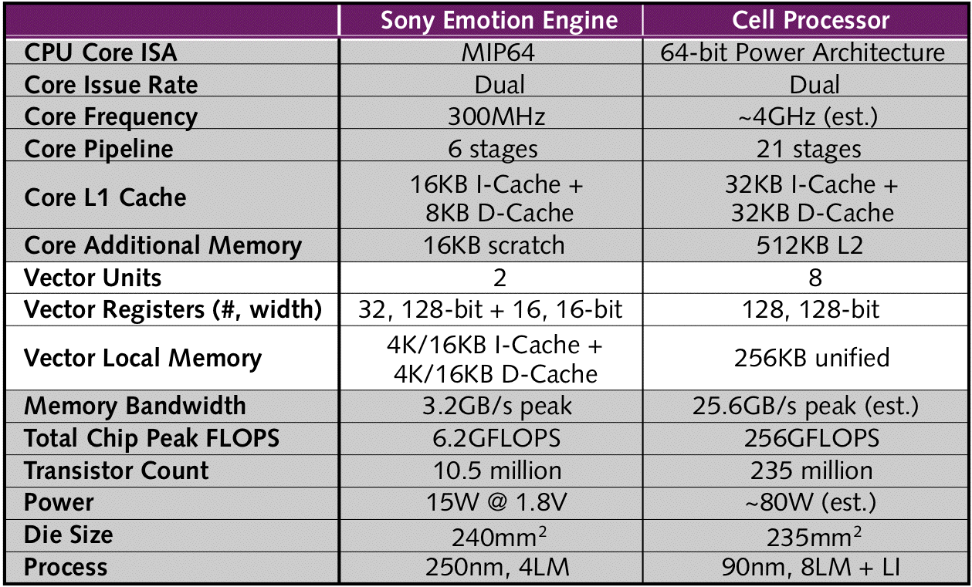
PlayStation 2 vs PlayStation 3
Source: Microprocessor Report: Feb 14, 2005

Slide 17
Power Efficient Processor Design and the
Cell Processor
H. Peter Hofstee, Ph. D.
Architect, Cell Synergistic Processor Element
IBM Systems and Technology Group
Austin, Texas
Notes:
Today I would like to talk about some of the trends we see in microprocessor development. As you’ve heard, IBM and my organization is now the major developer for game processors. Many people expect a next wave of innovation in processor and system design to come out of this space. This is a reasonable expectation, since gaming hardware, and particularly networked gaming hardware, occupies an increasingly central place in the home. The business models around content delivery on these platforms, now primarily games, but in the future most likely a much wider array of educational and entertainment (and perhaps even business!) applications, creates immense value and allows for a significant investment to be made in the development of these processors.
And to innovate, you need two things primarily, innovative people, and money!

Slide 18
I don’t have permission to distribute this part of the presentation, but the original slides are available at
http://www.hpcaconf.org/hpca11/slides/Cell_Public_Hofstee.pdf
and a paper on the Cell is available at: http://www.hpcaconf.org/hpca11/papers/25_hofstee-cellprocessor_final.pdf

Slide 19
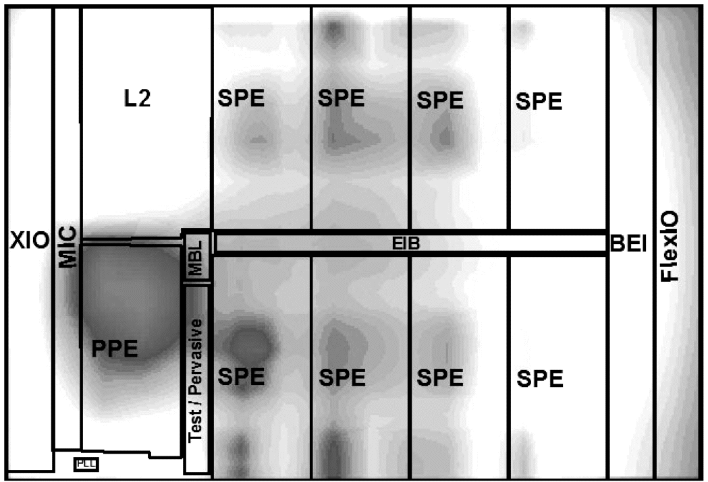
Cell Temperature Graph
Source: IEEE ISSCC, 2005
Power and heat are key constrains
  Cell is ~80 watts at 4+ Ghz
  Cell has 10 temperature sensors
  Prediction: PS3 will be more like 3 Ghz

Slide 20
Comments on XDR
XDR is new high-speed memory from Rambus
  Rambus not popular on desktop
  Rambus is used in game consoles, however.
Pros:
  Fast - dual controllers give 25GB/sed
    Current AMD Opteron is only 6.4GB/s
  Small pin count
  Only need a few chips for high bandwidth
Cons:
  Expensive ($ per bit)
  Next generation consoles will have only ~256 MB (maybe 512MB)
How will XDR dependence affect Cell’s broader impact?

Slide 21
Programming Cell
10 virtual processors
  2 threads of PowerPC
  8 co-processor SPEs
Communicating with SPEs
  Does not share the same address space
  256kB “local storage” is NOT a cache
    Must explicitly move data in and out of local store
    Full/empty bit support?
    Use DMA engine (supports scatter/gather)
Programming models (easier than a GPU?):
  Staged or independent
  Parallel
  Roaming chunks of code and data (not much detail here yet)
Likely model: fast library routines written by experts
  OpenGL & DirectX, of course

Slide 22
Cell Features
Real-time support
  Locking caches, bandwidth measurements
  Run-time predictability
Security
  SPE can act as a secure co-processor
  Probably good for cryptography
Networking
  SPEs might off-load networking overheads (TCP/IP)
Virtualization
  Run multiple Oss at the same time
  Note: Linux is primary development OS for Cell
PS3 will use an external GPU, too.
  Like PS2
  (What about PS2 compatibility?)

Slide 23
Long-term Impact?
Cell will be a solid base for PS3
  Fixes mistakes of PS2
  Makes new mistakes? (local store vs. caches)
Cell Workstation
  IBM will sell a mid-range 2-Cell workstation running Linux
  Might have some demand
    but main PowerPC processor is slower than G5
Will Apple use it?
  Internally, yes.
  But will they release it? Unlikely
Home media/HDTV
  Maybe, but size of this market is unknown

Slide 24
My Predictions
Similar in impact to PS2’s Emotion Engine Cell
  "Similar claims to those now being made for Cell were made in the past about the Sony/Toshiba chip called the Emotion Engine, which lies at the heart of the PlayStation 2. This was also supposed to be suitable for non-gaming uses. Yet the idea went nowhere..." - The Economist
Works great in PS3
  Sony might ship a PS3.5 with more SPEs
Not used in supercomputers
  Need more double-precision computation power
Not a threat to Windows/Intel
  Too much software lock-in

